Slide 1
Hedonic Clustering Games
Moran Feldman
Joint work with: Seffi Naor and Liane Lewin-Eytan

Slide 2
Outline
What are Hedonic Clustering Games?
Games we consider:
  The k-Median game.
  The k-Center game (really quickly).
  The Correlation Clustering game.
    Minimization variant.
    Maximization variant.
Open questions.

Slide 3
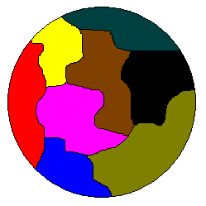
Background
Clustering Problems
Partitioning a set of points with respect to a given similarity measure.
Many different models.
Most works approach clustering from a global optimization perspective.
  There are known approximation algorithms for all models we consider.
Hedonic Games
Each player chooses a coalition to belong to.
The strategy of a player corresponds to the coalition she chose.
The utility (or cost) of a player depends solely on the identity of the members of its coalition.

Slide 4


Clustering Games
Many clustering problems have a natural game associated with them.
Players
Points
Strategies
The clusters a point can join.
Social Value
The objective of the (original) clustering problem.
Player Utility
Similar “in sprit” to the social value.

Slide 5
Clustering Games (cont.)
For many natural clustering models, the corresponding game is (almost) hedonic.
For each such game, we are interested in the following questions:
What is the price of anarchy?
What is the price of stability?
Is the game guaranteed to
have a Nash equlibrium?

Slide 6
Related Work
Hedonic Games
  Were introduced by Dreze and Greenberg (1980) in the context of cooperative games.
  Most works on them concentrate on notions of stability [BKS98, BD10, BJ02].
Clustering problems
  Many clustering problems were considered in the literature.
  There are known approximation algorithms for all models we consider [CGW03, G85, V01].

Slide 7
Related Work (cont.)
A few clustering games similar to ours were considered. The most relevant of which are:
  A game theoretic version of the Max-Cut problem [GM09].
  A game called Max-Agree [H07].
    A version of our Correlation Clustering game with equal node weights and a limit on the number of clusters.
    Results for this game are unlikely to hold for our game.
Other game theoretic representations of clustering were also considered [P09, B09].

Slide 8
k-Median
Problem Definition
Input: a weighted graph and a number k.
Output: a set of k centroids (nodes).
Goal: the cost of a node is its distance to the closest centroid. The goal is to minimize the total cost.
k = 3
Why is it a Clustering Problem?
We can think of each node as belonging to a cluster defined by its closest centroid.
Fixed Clustering
Since the number of clusters is fixed, we say this is a “fixed clustering” model.

Slide 9
k-Median as a Game
Game Definition
Each node of the graph is a player.
The strategies of a node are to choose one of k clusters.
Player Cost
The cost of a player is the distance between herself and the centroid of her cluster.
The centroid is the location minimizing the total cost of the cluster.
Social Cost
The social cost is the total cost of all players.

Slide 10
Notation
Penalties
When a node switch clusters, it may cause the centroid of the target cluster to move.
In a game with penalties, the node is charged for the distance the target centroid moved.
Intuitively, penalties stabilize the game.
Fractional Centroid Locations
Normally we allow a centroid to be located only at nodes of its cluster.
Fractional centroid locations means that the centroid can locate itself anywhere along an edge of the graph.

Slide 11
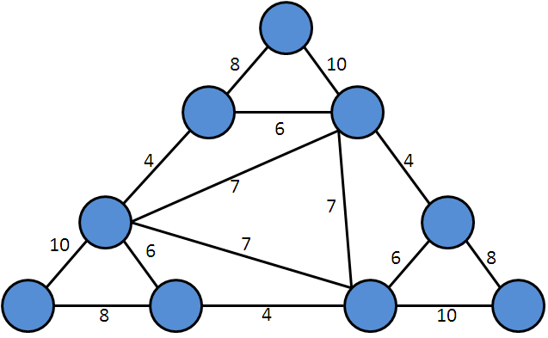
k-Median on General Graphs
The following graph with k = 2 has two properties:
  It has no Nash equilibrium.
  Allowing factional centroid locations does not introduce an equilibrium.
When penalties exist:
  Best response dynamics are guaranteed to converge to a Nash equilibrium.
  The price of stability is 1.
The price of anarchy is unbounded, even for line metrics.

Slide 12
k-Median on Trees
Line Metrics
The centroid of a cluster is one of its (up to 2) median nodes.
Best response dynamics converge.
  Proved using the above characterization and a potential function argument.
Tree Metrics
Nash equilibrium always exists.
The proof is a more involved version of the proof for line metrics.
We do not know how to prove that best response dynamics converge to equilibrium.
The price of stability is 1, and an optimal Nash can be found in polynomial time.

Slide 13

k-Center
The Problem
Same setting as in k-Median.
The objective function: minimizing the maximal distance between a node and a centroid.
The Game
Cluster cost: the maximal distance of a node in the cluster from the centroid.
The centroid still moves to minimize cluster cost.
Social cost: the maximum cluster cost.
k-median
k-center

Slide 14
k-Center (cont.)
Results
Most results are similar to their k-Median counterparts.
Somewhat different techniques.
Main different result:
  The existence of Nash equilibrium on trees is proved only for fractional centroid locations.
  On the other hand, general best response dynamics are proved to converge in this case.

Slide 15
Correlation Clustering
Problem Definition
Input: a graph with:
  Node weights.
  Metric [0, 1] edge weights (the edge weights are a similarity measure).
Output: a set of k clusters.
Goal:
  Minimize the distance of nodes from heavy similar nodes.
  Maximize the distance of nodes from heave dissimilar nodes.
Formally
Let C_{v} be the cluster of v.
Minimization variant goal:
Maximization variant goal:

Slide 16
Game Version
Node objective: minimize/maximize its part in the objective function.
Possible strategies:
  Switch to any of the existing clusters.
  Open a new cluster.
Immediate Results
The minimization and maximization variants have the same set of Nash equilibria.
  Proof: The utility functions of both variants add up to a constant.
Techniques used for a class of games called symmetric additively-separable hedonic games apply in our context:
min
const.
max
  Nash equilibrium always exists (a potential game).
  It is PLS-hard to find an equilibrium.

Slide 17
Price of Stability
Unweighted Case
The social cost is a potential function.
The price of stability is 1.
Weighted Case
The price of stability is larger.
In the unique Nash equilibrium of this graph, all nodes share a cluster.
In the optimal configuration, v shares a cluster with only one other node (either u₁ or u₂).
w_{v} = 4
v
0.4
0.4
u₁
u₂
0.8
w_{u1} = 1
w_{u2} = 1
Variant | Nash Equilibrium | Optimal Configuration | Price of Stability
Minimum | 5.6 | 5.4 | ≈ 1.037
Maximum | 6.4 | 6.6 | 1.03125

Slide 18
Price of Anarchy
Analysis uses two properties of Nash equalibria:
  If two nodes u and v share a cluster C in some Nash equilibrium, then:
  If two nodes u and v belong to two different clusters C_{u} and C_{v} in some Nash equilibrium, then:
Discussion
These properties are tight.
These properties show that a Nash equilibrium does not make extreme mistakes.

Slide 19
Minimization Variant
Min
Theorem
Assuming equal weights, the price of anarchy of the minimization variant is n-1.
Definition
An edge in a configuration is either an internal edge of a cluster, or an external edge connecting two different clusters.
Proof of Upper Bound
Assume w.l.o.g. all nodes have weight 1. Let E and O denote a Nash equilibrium and an optimal configuration, respectively.

Slide 20
Minimization Variant (cont.)
Min
If e is:
In E | In O | Then
Internal | Internal | e contributes 2[1- d(u, v)] to the social cost of both configurations.
External | External | e contributes 2d(u, v) to the social cost of both configurations.
Internal in cluster C | External | By property 1, d(e) ≤ 1 – 2 / (2w(C)) ≤ 1 – 1 / n. The cost e contributes to E ≤ 2(1 – 1/n). The cost contributed by e to O is at least 2/n. The ratio between these costs is at most:

Slide 21
Minimization Variant (cont.)
Min
In E | In O | Then
External | Internal | We get the same conclusion through property 2.
Conclusion
The cost contributed by e to E is always at most (n – 1) times the cost it contributes to O.
Hence, the total cost of E is at most n-1 times the total cost of O.
In other words, the price of anarchy is at most n – 1.
Theorem
For general weights, the price of anarchy of the minimization variant is O(n²).
Remark
The proof is based on the above two properties and the Cauchy-Schwarz inequality.

Slide 22
Maximization Variant
Max
Theorem
The price of anarchy of the maximization variant is:
Θ(n^{1/2}) for general metrics.
Θ(n^{1/3}) for line metrics.
At most k if we:
  First let the game converge with k clusters.
  Then return to the original rules.

Slide 23

Open Problems
For Fixed Clustering:
  Characterizing metrics for which there always exists a Nash equilibrium.
  Characterizing metrics for which best response dynamics always converge.
For Correlation Clustering:
  Better bounds on the price of anarchy of the minimization variant.
  Non-trivial upper bounds on the price of stability.
Introducing other interesting clustering games.

Slide 24
Questions
?

